Slide 1
Chapter 24
Electric Potential

Slide 2
24.1 What is Physics?:
Experimentally, physicists and engineers discovered that the electric force is conservative and thus has an associated electric potential energy.
The motivation for associating a potential energy with a force is that we can then apply the principle of the conservation of mechanical energy to closed systems involving the force.

Slide 3
Electric Potential Energy
When an electrostatic force acts between two or more charged particles within a system of particles, we can assign an electric potential energy U to the system.

Slide 4

Electric Potential Energy
If the system changes its configuration from an initial state i to a different final state f, the electrostatic force does work W on the particles. If the resulting change is ΔU, then

Slide 5
Electric Potential Energy
As with other conservative forces, the work done by the electrostatic force is path independent.

Slide 6

Electric Potential Energy
Usually the reference configuration of a system of charged particles is taken to be that in which the particles are all infinitely separated from one another. The corresponding reference potential energy is usually set be zero. Therefore,

Slide 7
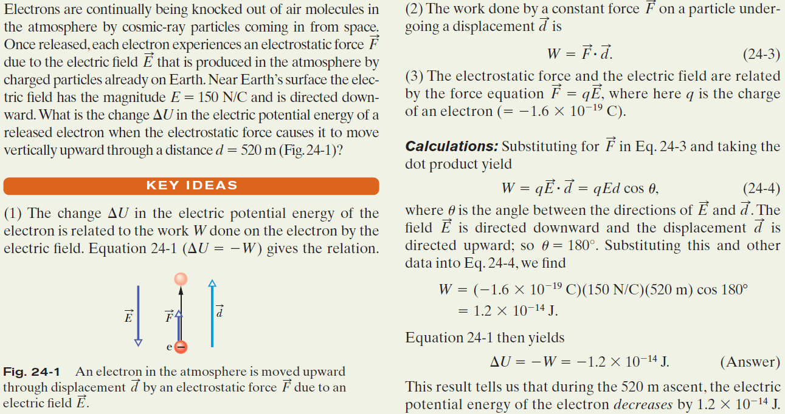
Example, Work and potential energy
in an electric field:

Slide 8
Example, Work and potential energy
in an electric field:

Slide 9
Example, Work and potential energy
in an electric field:

Slide 10
Example, Work and potential energy
in an electric field:

Slide 11
Example, Work and potential energy in an electric field:

